Slide 1

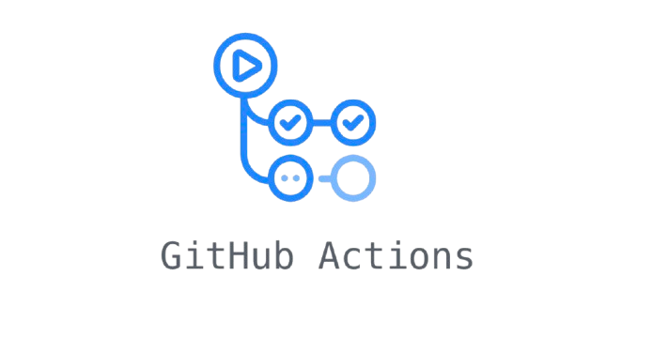
CI/CD By: Carlos Murillo, Nicholas Dobard, and Norman Cattles (Pod 6)

Slide 2
What is Continuous Integration?
CI is an approach to software development that automates repetitive and error-prone tasks that also promotes consistently integrated environments
In simpler terms, it is the automated building and testing of your application on every push to a shared repository
Continuous integrations consists of 4 main steps:
Commit
Build
Test
Inform

Slide 3
What is Continuous Deployment?
The automated deployment of successful code changes from a pre-production environment into production
If all tests pass, every new commit deploys directly to production without the need for manual intervention
Continuous Deployment consists of 3 main steps:
Deployment
Monitoring
Feedback

Slide 4
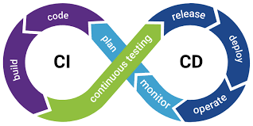
What is a CI/CD Pipeline?
A sequence of automated steps to deliver software from development to production
Key Stages
Source: Triggered by code changes (code push or pull request)
Build: Compiling and packaging the application
Test: Running unit, integration, and system tests
Deploy: Releasing the application to staging or production

Slide 5
What are the Benefits?
Version control
Faster release cycles
Code quality improvements
Enhanced team collaboration

Slide 6
History of CI/CD
1990s
Manual Integration and Testing
Early development relied on manual code merges and testing, causing delays and frequent integration issues
Early 2000s
Adoption of CI on Physical Servers
Companies deployed CI tools like Jenkins (2004) and CruiseControl (2001) on physical servers, requiring significant infrastructure management
2000s
Challenges with On-Premise CI/CD
Scaling required more hardware, maintenance was costly, and downtime during upgrades was common
2010s
Transition to Cloud-Based CI/CD
Cloud services like Travis CI (2011) and GitHub Actions (2019) eliminated the need for companies to manage servers, offering scalable and automated CI/CD solutions

Slide 7
GitHub Actions
What is GitHub Actions?
Introduce Workflows
Events/Jobs/Runners
Integration with GitHub

Slide 8
What is GitHub Actions?
GitHub’s Native CI/CD Tool
Automates workflows directly within GitHub repositories
Workflow Automation
Uses YAML files to define automated processes like builds, tests, and deployments
Event-Driven
Triggers workflows based on GitHub events (e.g., push, pull_request, or schedule)
Highly Customizable
Supports custom actions, parallel jobs, and matrix builds for flexible automation
Seamless Integration
Built into GitHub, enabling easy integration with existing projects and third-party services

Slide 9
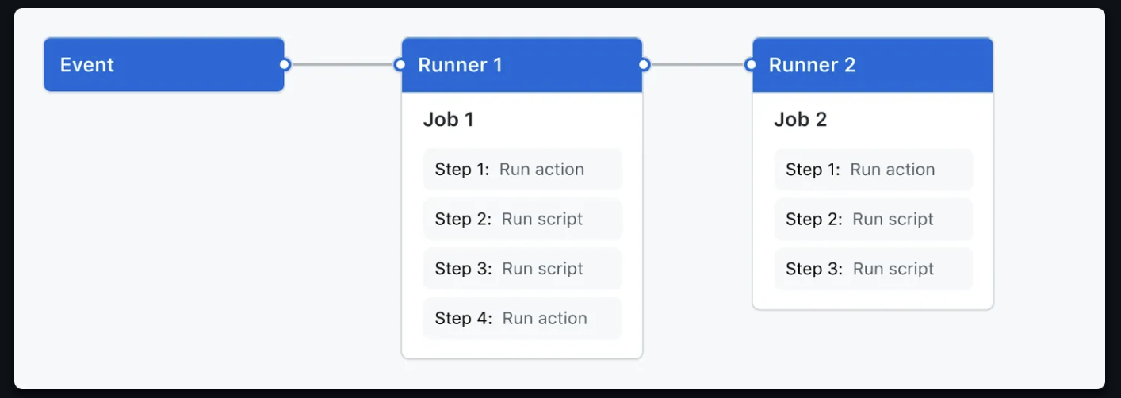
Workflows
Definition: Automated processes defined in YAML files that run jobs in response to GitHub events (e.g., push, pull_request)
Location: Workflows are stored in the .github/workflows/ directory of your repository

Slide 10
Workflows
Components
Triggers: Conditions that initiate a workflow in response to specific events, like a code push
Jobs: A collection of steps executed on virtual machines (runners), which can run in parallel or sequentially
Steps: Individual commands or actions that are part of a job

Slide 11
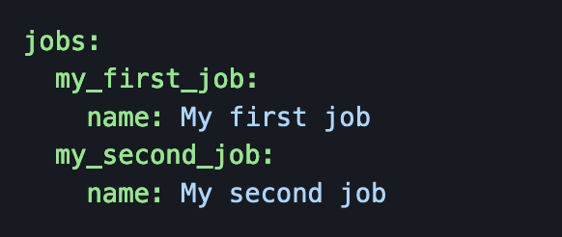
Jobs
Definition
A set of steps that are executed sequentially within a workflow
Parallel Execution
Multiple jobs can run simultaneously by default, improving workflow efficiency
Runs on Virtual Machines
Each job runs in its own isolated environment (runner), such as Ubuntu, macOS, or Windows
Dependencies Between Jobs
Jobs can be set to run sequentially or dependent on the success of other jobs

Slide 12
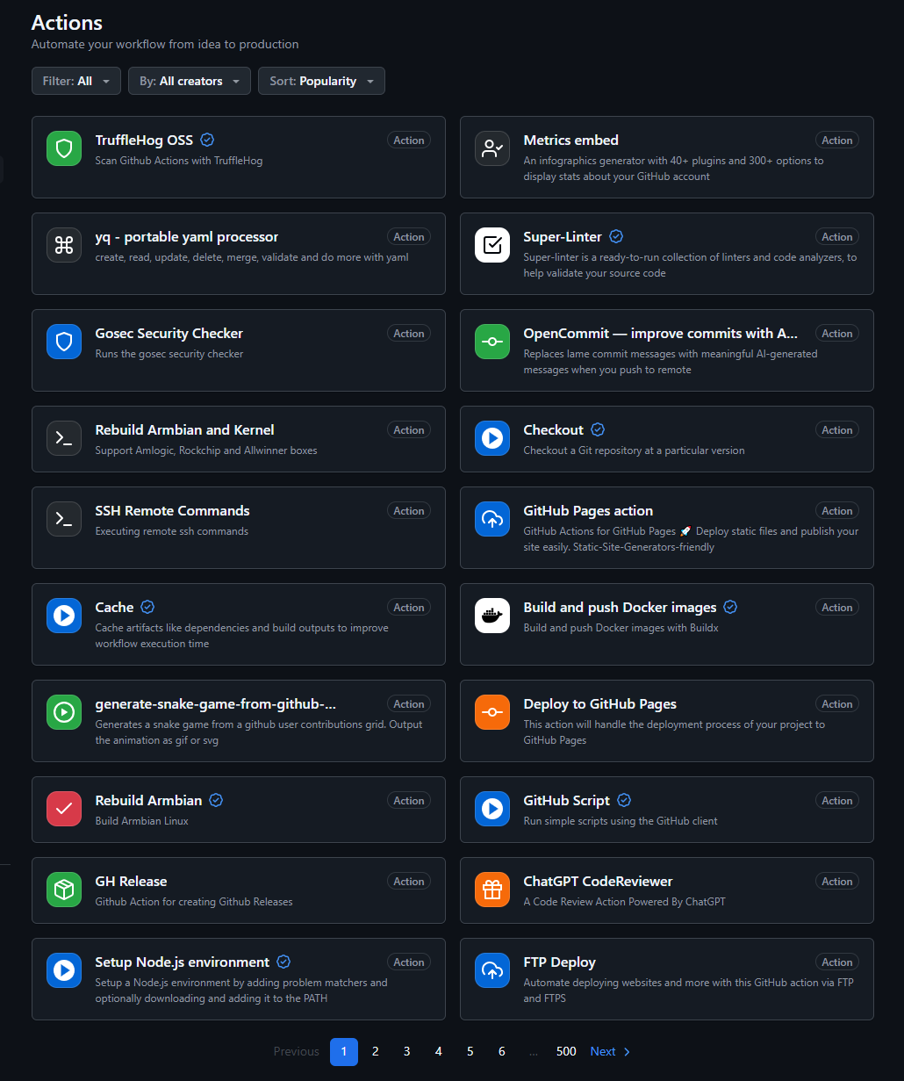
Actions
Definition
Predefined, reusable tasks that perform specific functions within a job
Reusable Across Projects
Actions can be reused in multiple workflows or repositories, saving time and effort
Types of Actions
Built-In Actions: Provided by GitHub, like actions/checkout to clone a repository
Custom Actions: Created by developers to perform specific tasks
Marketplace
GitHub Actions Marketplace offers thousands of ready-made actions for common tasks (e.g., building, testing, deploying)
Used in Steps: Actions are invoked within steps to automate tasks

Slide 13
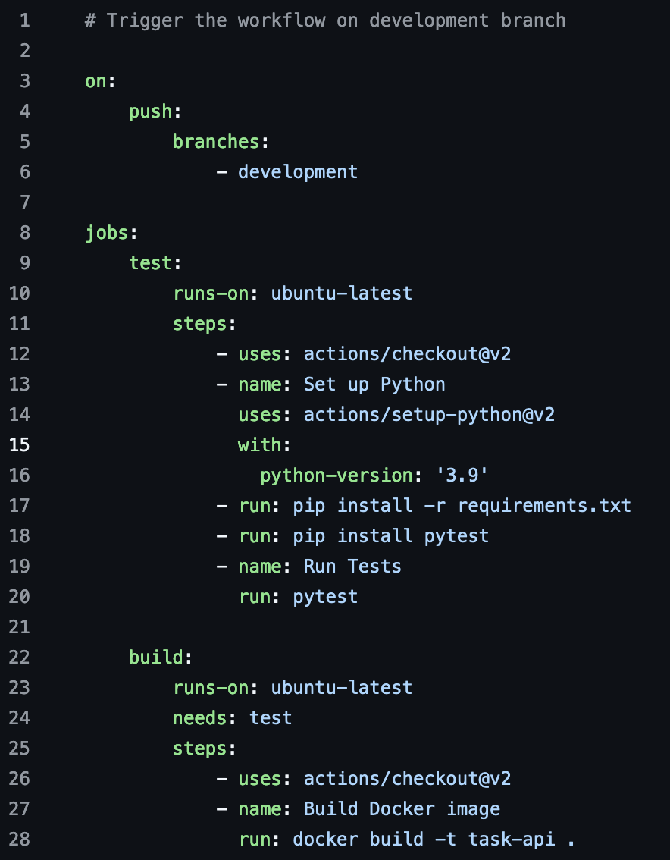
Jobs
Event/Trigger
Jobs

Slide 14
Workflow Trivia

Slide 15
Building a CI/CD Pipeline with GitHub Actions

Slide 16
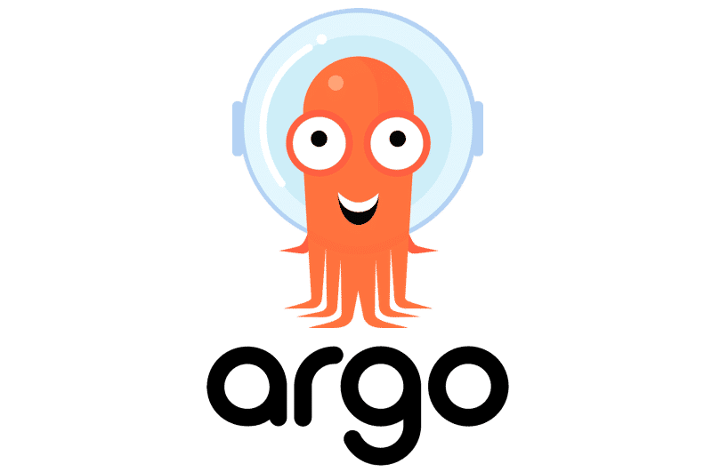
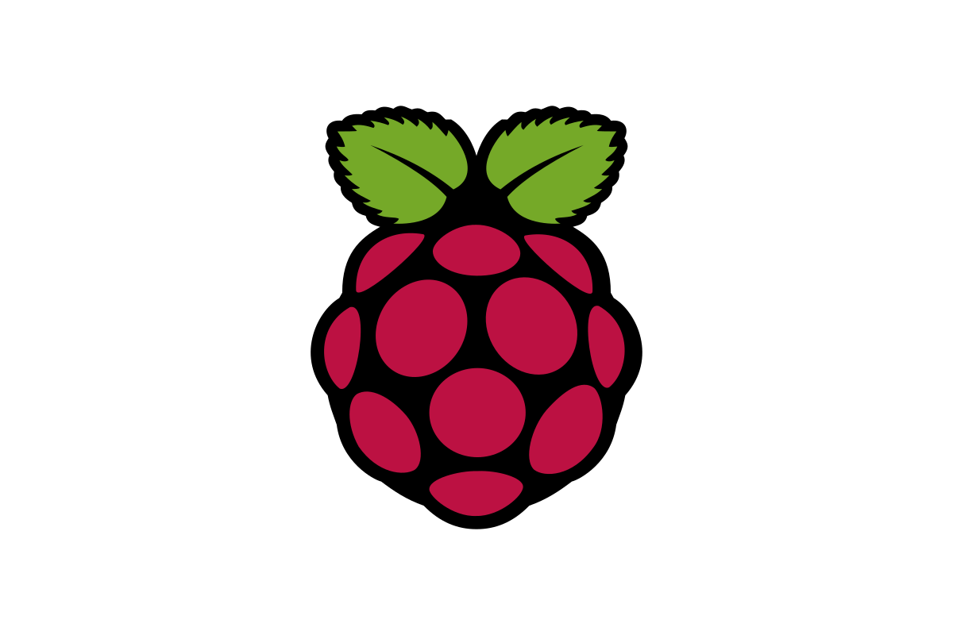
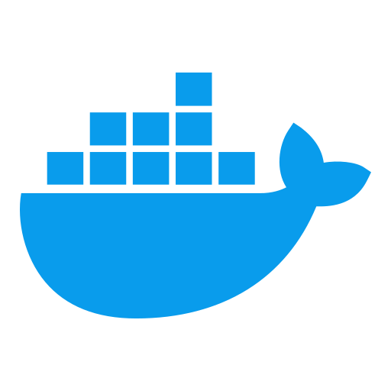
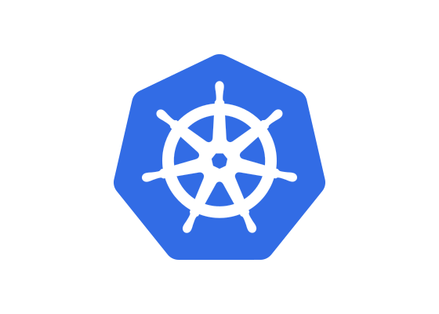
Touchless Kiosk Integration
GitHub Actions:
Builds a new Docker image when code is pushed to the main branch
Pushes the image to a container registry
Updates the Kubernetes deployment config in the repo
Kubernetes (K3s or MicroK8s):
Runs containers on Raspberry Pis
Manages deployments
ArgoCD:
Monitors the repo for config changes
Automatically updates Kubernetes with the new image version
Ensures seamless deployment across all Raspberry Pis

Slide 17
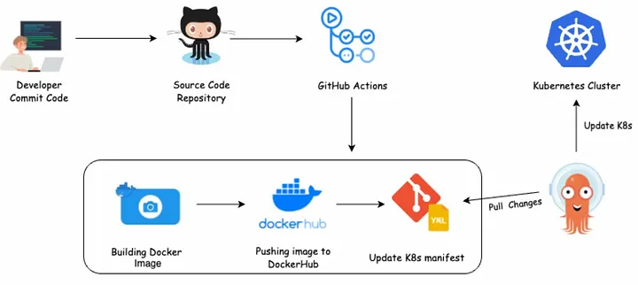
Touchless Kiosk Integration

Slide 18
Deliverable
Create a GitHub Actions Workflow and upload it to GitHub!

Slide 19

Questions? / Happy Halloween

